Slide 1
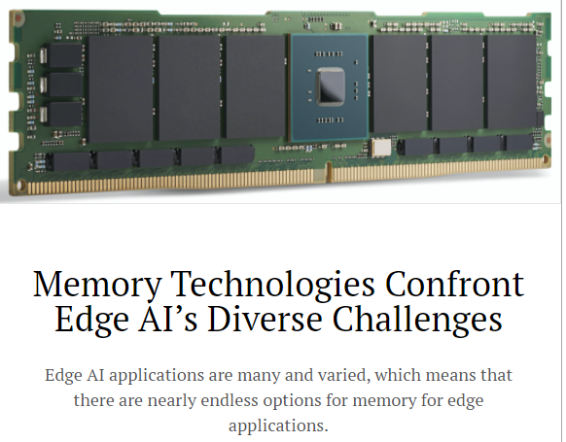
Computer Architecture
（计算机体系结构） Lecture 9 MIPS Instruction Representation II 2020-09-21
Lecturer
Yuanqing Cheng

Slide 2
Review
Simplifying MIPS: Define instructions to be same size as data word (one word) so that they can use the same memory (compiler can use lw and sw).
Computer actually stores programs as a series of these 32-bit numbers.
MIPS Machine Language Instruction: 32 bits representing a single instruction
R
opcode
rs
rt
rd
shamt
funct
I
opcode
rs
rt
immediate

Slide 3
I-Format Problems (0/3)
Problem 0: Unsigned # sign-extended?
addiu, sltiu, sign-extends immediates to 32 bits. Thus, # is a “signed” integer.
Rationale
addiu so that can add w/out overflow
See K&R pp. 230, 305
sltiu suffers so that we can have easy HW
Does this mean we’ll get wrong answers?
Nope, it means assembler has to handle any unsigned immediate 2¹⁵ ≤ n < 2¹⁶ (I.e., with a 1 in the 15th bit and 0s in the upper 2 bytes) as it does for numbers that are too large. ⇒

Slide 4
I-Format Problem (1/3)
Problem:
Chances are that addi, lw, sw and slti will use immediates small enough to fit in the immediate field.
…but what if it’s too big?
We need a way to deal with a 32-bit immediate in any I-format instruction.

Slide 5
I-Format Problem (2/3)
Solution to Problem:
Handle it in software + new instruction
Don’t change the current instructions: instead, add a new instruction to help out
New instruction:
lui register, immediate
stands for Load Upper Immediate
takes 16-bit immediate and puts these bits in the upper half (high order half) of the register
sets lower half to 0s

Slide 6
I-Format Problems (3/3)
Solution to Problem (continued):
So how does lui help us?
Example:
addiu $t0,$t0, 0xABABCDCD
…becomes
lui $at 0xABAB ori $at, $at, 0xCDCD addu $t0,$t0,$at
Now each I-format instruction has only a 16-bit immediate.
Wouldn’t it be nice if the assembler would this for us automatically? (later)

Slide 7
Branches: PC-Relative Addressing (1/5)
Use I-Format
opcode specifies beq versus bne
rs and rt specify registers to compare
What can immediate specify?
immediate is only 16 bits
PC (Program Counter) has byte address of current instruction being executed; 32-bit pointer to memory
So immediate cannot specify entire address to branch to.
opcode
rs
rt
immediate

Slide 8
Branches: PC-Relative Addressing (2/5)
How do we typically use branches?
Answer: if-else, while, for
Loops are generally small: usually up to 50 instructions
Function calls and unconditional jumps are done using jump instructions (j and jal), not the branches.
Conclusion: may want to branch to anywhere in memory, but a branch often changes PC by a small amount

Slide 9
Branches: PC-Relative Addressing (3/5)
Solution to branches in a 32-bit instruction: PC-Relative Addressing
Let the 16-bit immediate field be a signed two’s complement integer to be added to the PC if we take the branch.
Now we can branch ± 2¹⁵ bytes from the PC, which should be enough to cover almost any loop.
Any ideas to further optimize this?

Slide 10
Branches: PC-Relative Addressing (4/5)
Note: Instructions are words, so they’re word aligned (byte address is always a multiple of 4, which means it ends with 00 in binary).
So the number of bytes to add to the PC will always be a multiple of 4.
So specify the immediate in words.
Now, we can branch ± 2¹⁵ words from the PC (or ± 2¹⁷ bytes), so we can handle loops 4 times as large.

Slide 11
Branches: PC-Relative Addressing (5/5)
Branch Calculation:
If we don’t take the branch:
PC = PC + 4 = byte address of next instruction
If we do take the branch:
PC = (PC + 4) + (immediate * 4)
Observations
Immediate field specifies the number of words to jump, which is simply the number of instructions to jump.
Immediate field can be positive or negative.
Due to hardware, add immediate to (PC+4), not to PC; will be clearer why later in course

Slide 12
Branch Example (1/3)
MIPS Code:
Loop: beq $9,$0,End addu $8,$8,$10 addiu $9,$9,-1 j Loop End:
beq branch is I-Format:
opcode = 4 (look up in table)
rs = 9 (first operand)
rt = 0 (second operand)
immediate = ???

Slide 13
Branch Example (2/3)
MIPS Code:
Loop: beq $9,$0,End addu $8,$8,$10 addiu $9,$9,-1 j Loop End:
immediate Field:
Number of instructions to add to (or subtract from) the PC, starting at the instruction following the branch.
In beq case, immediate = 3

Slide 14
Branch Example (3/3)
MIPS Code:
Loop: beq $9,$0,End addu $8,$8,$10 addiu $9,$9,-1 j Loop End:
decimal representation:
4
9
0
3
binary representation:
000100
01001
00000
0000000000000011

Slide 15
Questions on PC-addressing
Does the value in branch field change if we move the code?
What do we do if destination is > 2¹⁵ instructions away from branch?
Why do we need different addressing modes (different ways of forming a memory address)? Why not just one?

Slide 16
J-Format Instructions (1/5)
For branches, we assumed that we won’t want to branch too far, so we can specify change in PC.
For general jumps (j and jal), we may jump to anywhere in memory.
Ideally, we could specify a 32-bit memory address to jump to.
Unfortunately, we can’t fit both a 6-bit opcode and a 32-bit address into a single 32-bit word, so we compromise.

Slide 17
J-Format Instructions (2/5)
Define two “fields” of these bit widths:
As usual, each field has a name:
Key Concepts
Keep opcode field identical to R-format and I-format for consistency.
Collapse all other fields to make room for large target address.
6 bits
26 bits
opcode
target address

Slide 18
J-Format Instructions (3/5)
For now, we can specify 26 bits of the 32-bit bit address.
Optimization:
Note that, just like with branches, jumps will only jump to word aligned addresses, so last two bits are always 00 (in binary).
So let’s just take this for granted and not even specify them.

Slide 19
J-Format Instructions (4/5)
Now specify 28 bits of a 32-bit address
Where do we get the other 4 bits?
By definition, take the 4 highest order bits from the PC.
Technically, this means that we cannot jump to anywhere in memory, but it’s adequate 99.9999…% of the time, since programs aren’t that long
only if straddle a 256 MB boundary
If we absolutely need to specify a 32-bit address, we can always put it in a register and use the jr instruction.

Slide 20
J-Format Instructions (5/5)
Summary:
New PC = { PC[31..28], target address, 00 }
Understand where each part came from!
Note: { , , } means concatenation { 4 bits , 26 bits , 2 bits } = 32 bit address
{ 1010, 11111111111111111111111111, 00 } = 10101111111111111111111111111100
Note: Book uses ||

Slide 21
Peer Instruction Question
(for A,B) When combining two C files into one executable, recall we can compile them independently & then merge them together.
Jump insts don’t require any changes.
Branch insts don’t require any changes.
12
a) FF
b) FT
c) TF
d) TT
e)dunno
Notes:
Answer: (b)
1: False
2: True (it’s all relative)

Slide 22
In conclusion
MIPS Machine Language Instruction: 32 bits representing a single instruction
Branches use PC-relative addressing, Jumps use absolute addressing.
Disassembly is simple and starts by decoding opcode field. (more in a week)
R
opcode
rs
rt
rd
shamt
funct
I
opcode
rs
rt
immediate
J
opcode
target address

