Slide 1
Computer Architecture
（计算机体系结构） Lecture #16 State Elements: Circuits that Remember 2020-10-09
Yuanqing Cheng
www.cadetlab.cn/~courses
Notes:
Greet class

Slide 2
Review
ISA is very important abstraction layer
Contract between HW and SW
Clocks control pulse of our circuits
Voltages are analog, quantized to 0/1
Circuit delays are fact of life
Two types of circuits:
Stateless Combinational Logic (&,|,~)
State circuits (e.g., registers)

Slide 3
Uses for State Elements
As a place to store values for some indeterminate amount of time:
Register files (like $1-$31 on the MIPS)
Memory (caches, and main memory)
Help control the flow of information between combinational logic blocks.
State elements are used to hold up the movement of information at the inputs to combinational logic blocks and allow for orderly passage.

Slide 4
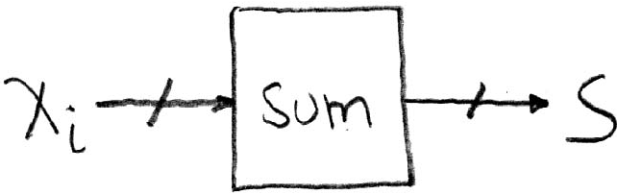
Accumulator Example
Why do we need to control the flow of information?
Want: S=0;
for (i=0;i<n;i++)
S = S + X_{i}
Assume:
Each X value is applied in succession, one per cycle.
After n cycles the sum is present on S.

Slide 5
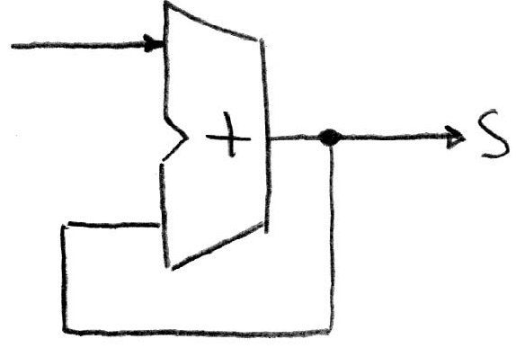
First try…Does this work?
Feedback
Nope!
Reason #1… What is there to control the next iteration of the ‘for’ loop?
Reason #2… How do we say: ‘S=0’?

Slide 6
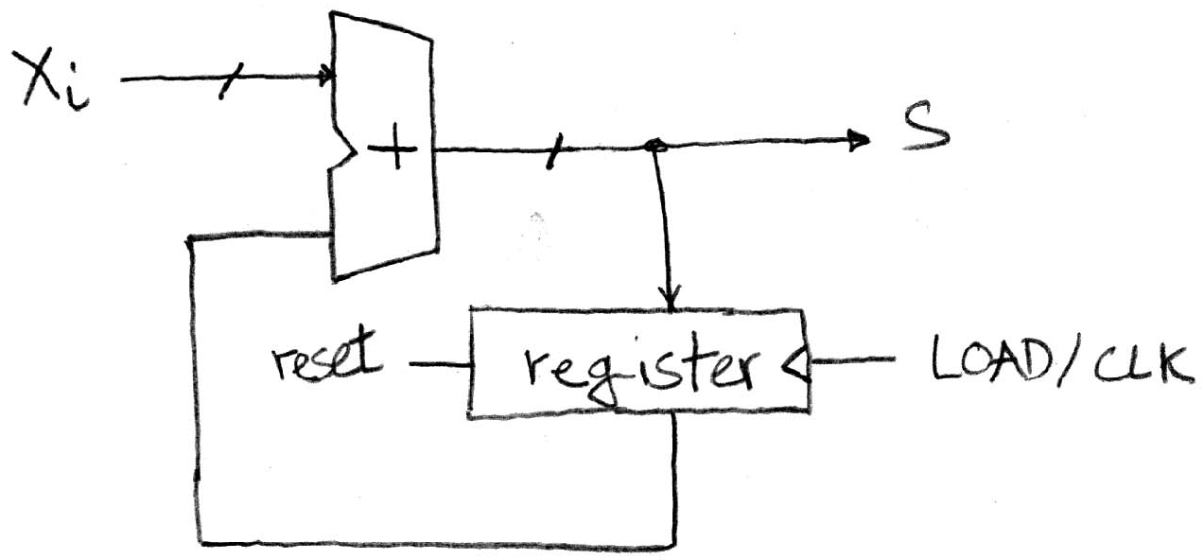
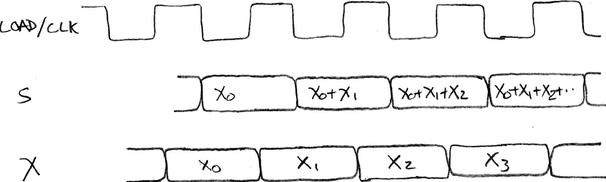
Second try…How about this?
Rough timing…
Register is used to hold up the transfer of data to adder.

Slide 7
Register Details…What’s inside?
n instances of a “Flip-Flop”
Flip-flop name because the output flips and flops between and 0,1
D is “data”, Q is “output”
Also called “d-type Flip-Flop”

Slide 8
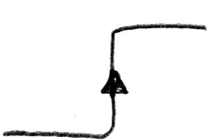
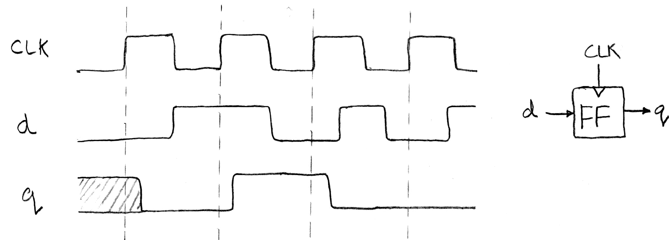
What’s the timing of a Flip-flop? (1/2)
Edge-triggered d-type flip-flop
This one is “positive edge-triggered”
“On the rising edge of the clock, the input d is sampled and transferred to the output. At all other times, the input d is ignored.”
Example waveforms:

Slide 9
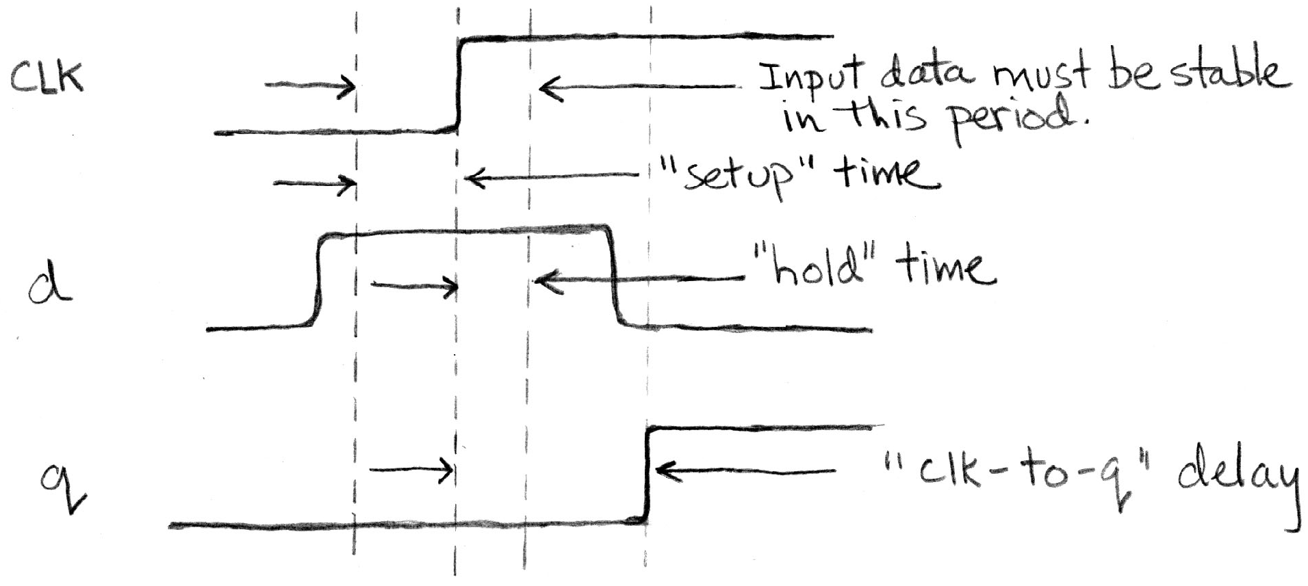
What’s the timing of a Flip-flop? (2/2)
Edge-triggered d-type flip-flop
This one is “positive edge-triggered”
“On the rising edge of the clock, the input d is sampled and transferred to the output. At all other times, the input d is ignored.”
Example waveforms (more detail):

Slide 10
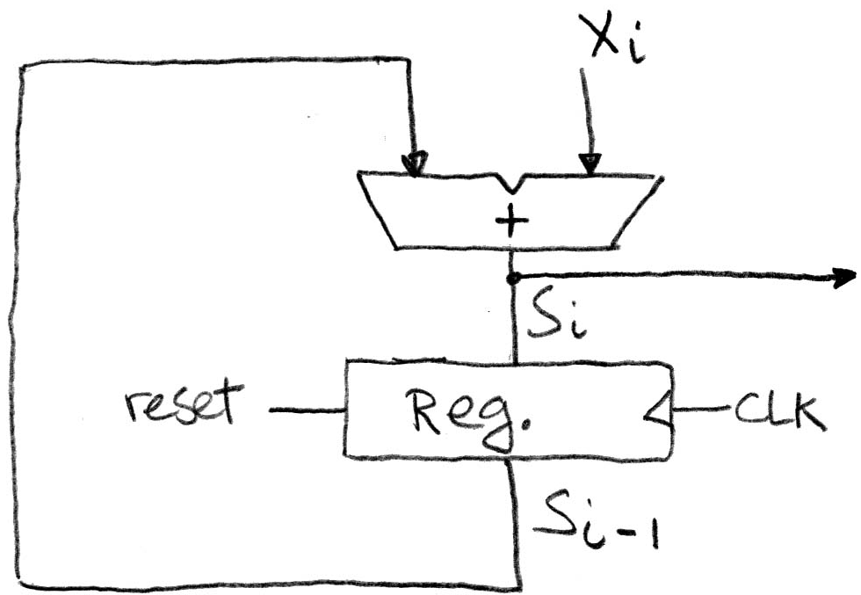
Accumulator Revisited (proper timing 1/2)
Reset input to register is used to force it to all zeros (takes priority over D input).
S_{i-1} holds the result of the i^{th}-1 iteration.
Analyze circuit timing starting at the output of the register.

Slide 11
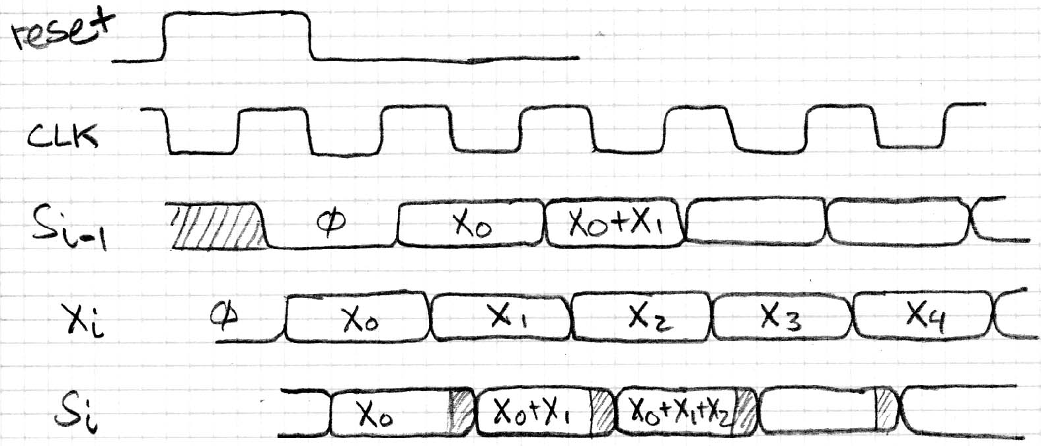
Accumulator Revisited (proper timing 2/2)
reset signal shown.
Also, in practice X might not arrive to the adder at the same time as S_{i-1}
S_{i} temporarily is wrong, but register always captures correct value.
In good circuits, instability never happens around rising edge of clk.

Slide 12
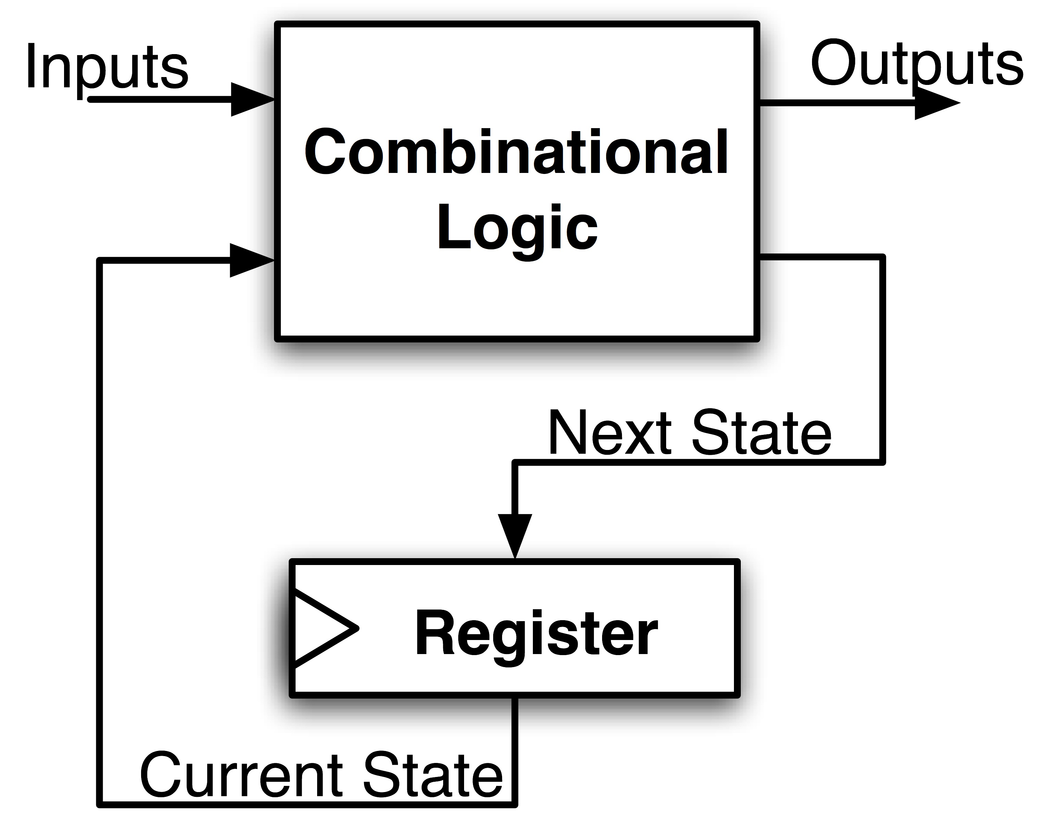
Maximum Clock Frequency
Hint…
Frequency = 1/Period
What is the maximum frequency of this circuit?
Max Delay = Setup Time + CLK-to-Q Delay
+ CL Delay

Slide 13
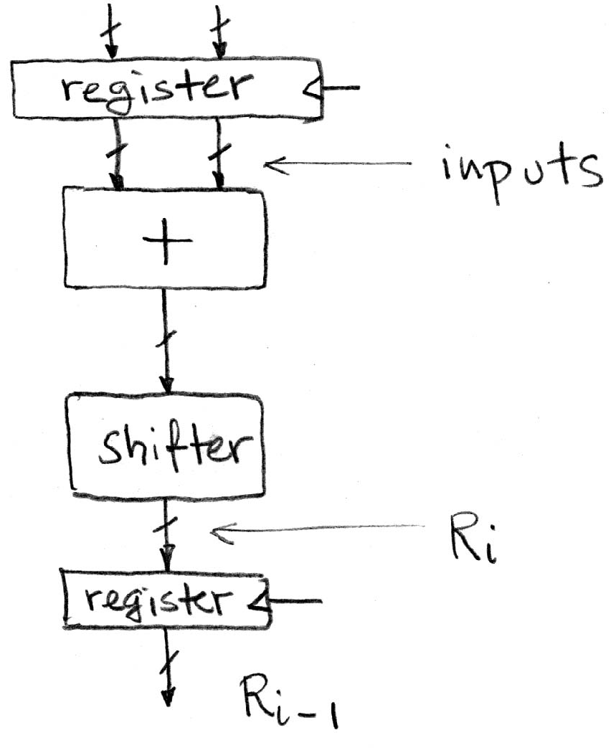
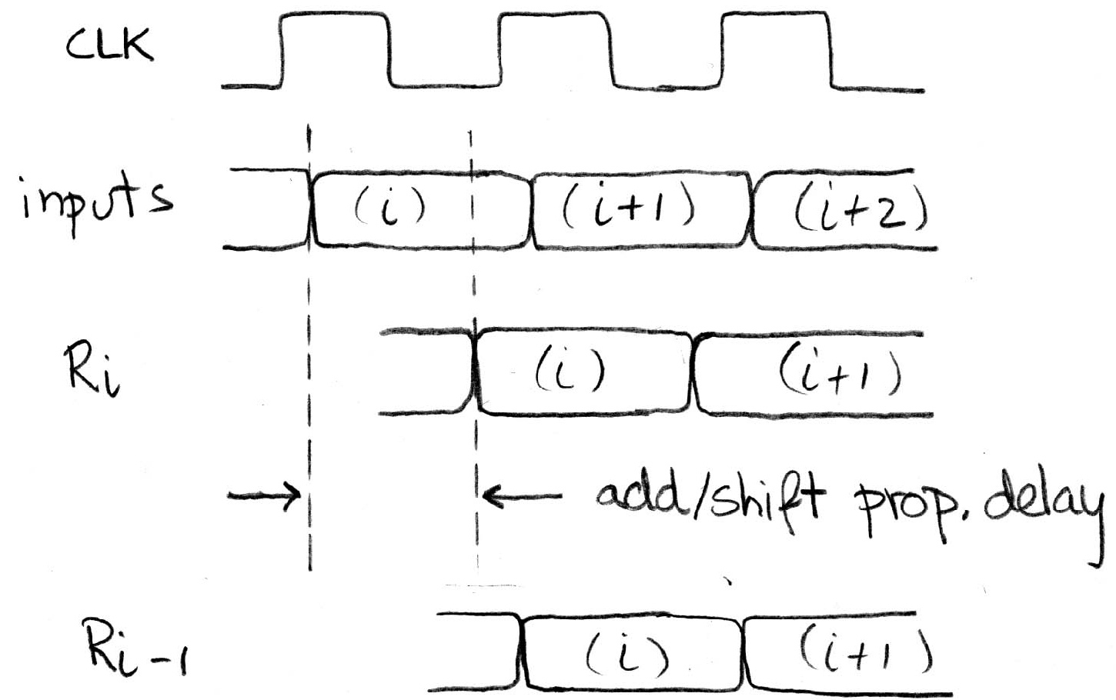
Pipelining to improve performance (1/2)
Extra Register are often added to help speed up the clock rate.
Timing…
Note: delay of 1 clock cycle from input to output.
Clock period limited by propagation delay of adder/shifter.

Slide 14
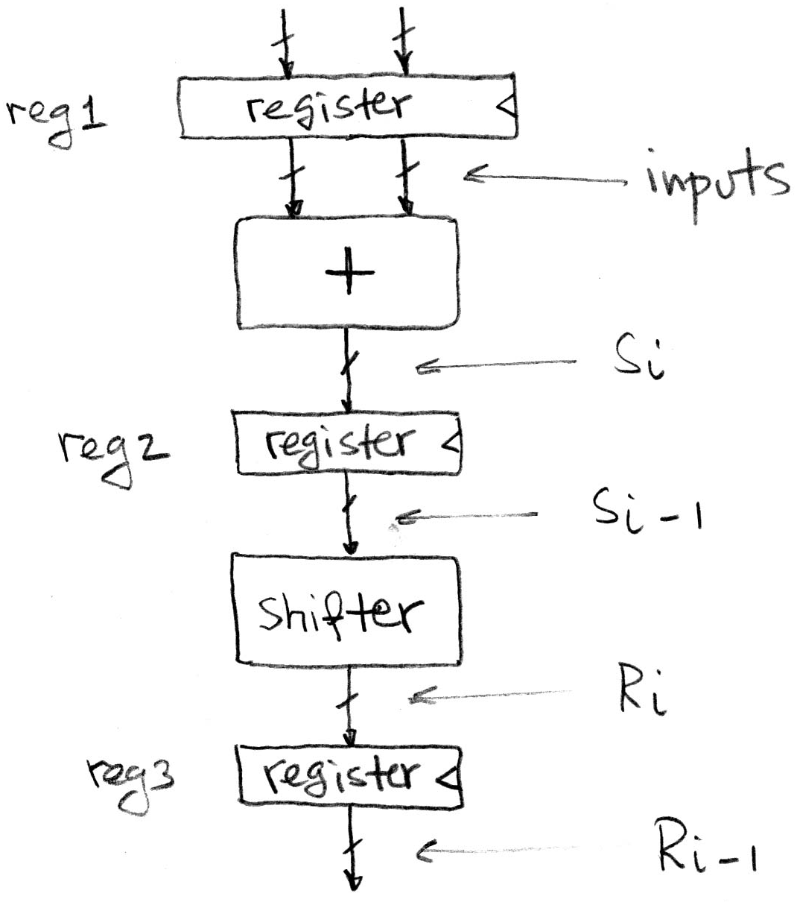
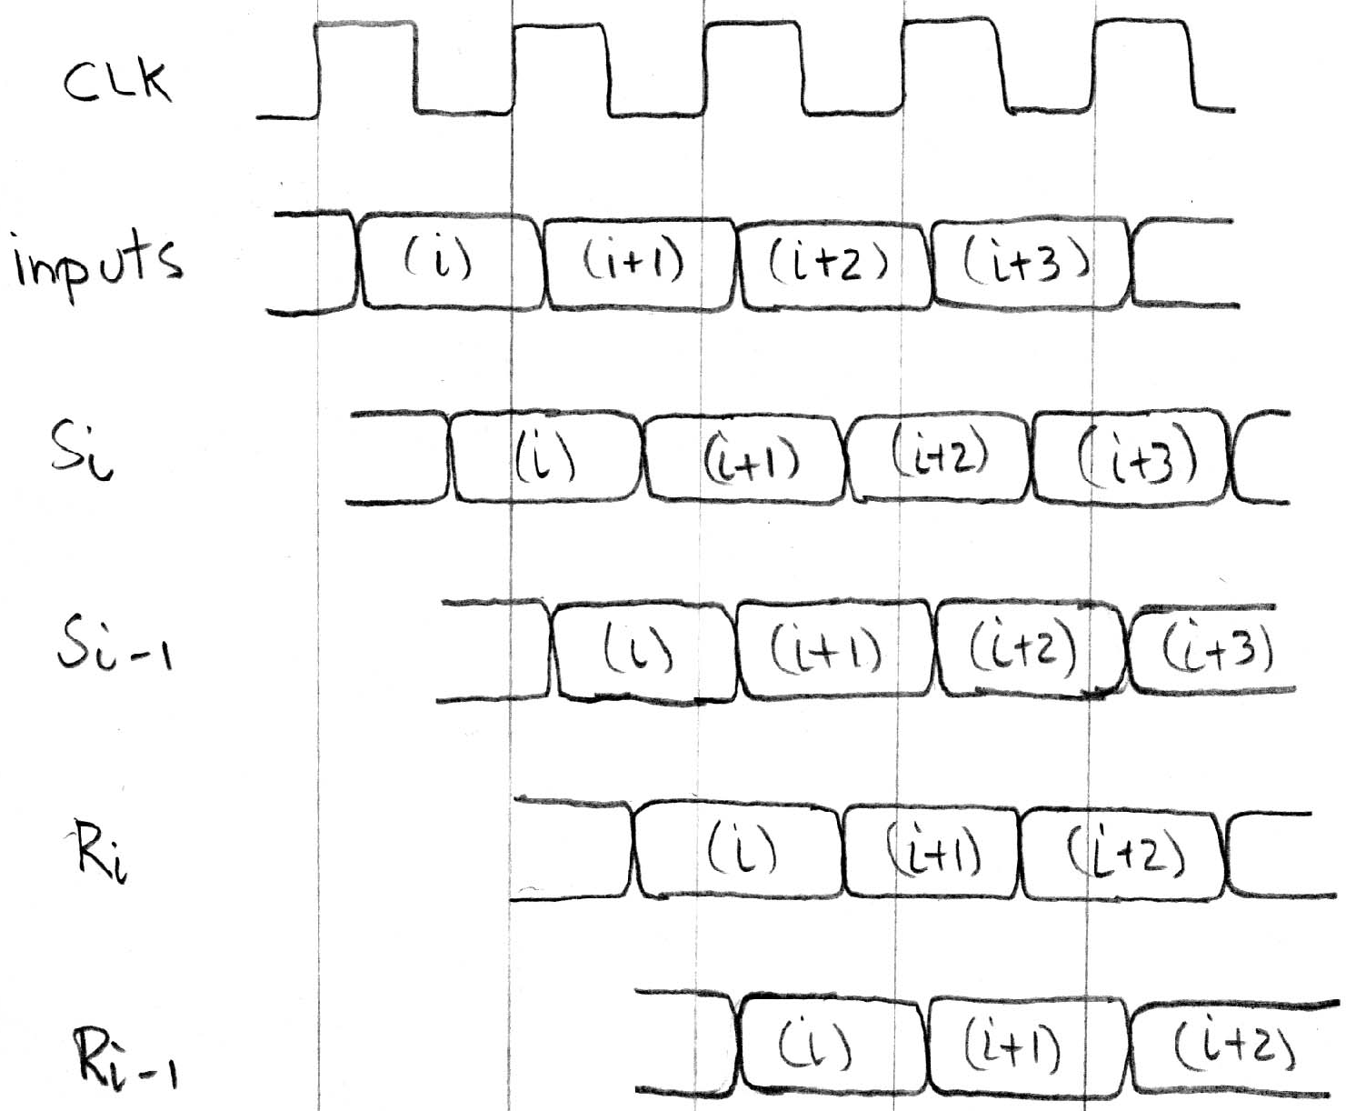
Pipelining to improve performance (2/2)
Insertion of register allows higher clock frequency.
More outputs per second.
Timing…

Slide 15
Recap of Timing Terms
Clock (CLK) - steady square wave that synchronizes system
Setup Time - when the input must be stable before the rising edge of the CLK
Hold Time - when the input must be stable after the rising edge of the CLK
“CLK-to-Q” Delay - how long it takes the output to change, measured from the rising edge
Flip-flop - one bit of state that samples every rising edge of the CLK
Register - several bits of state that samples on rising edge of CLK or on LOAD

Slide 16
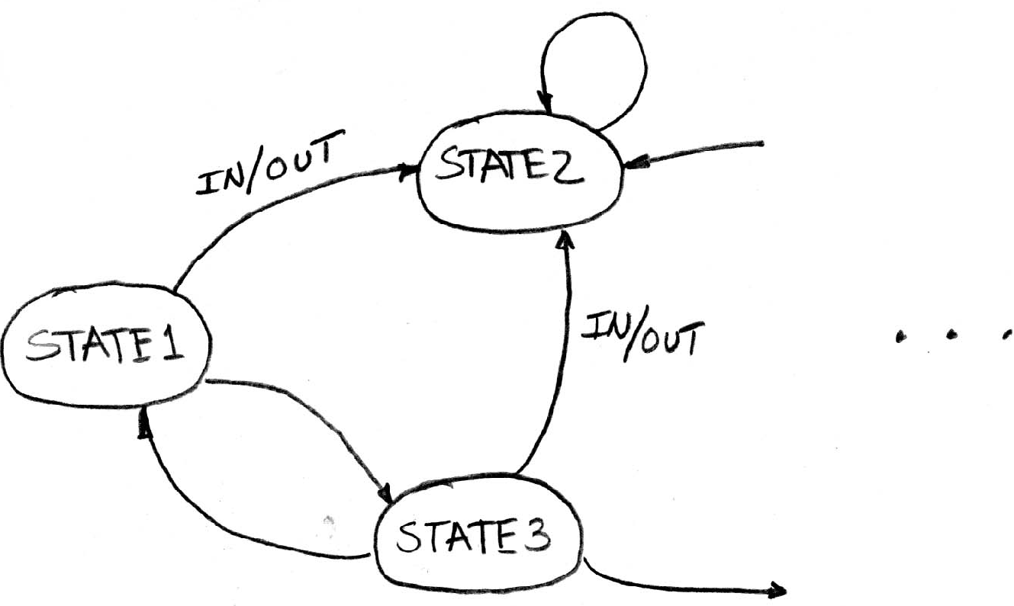
Finite State Machines (FSM) Introduction
You have seen FSMs in other classes.
Same basic idea.
The function can be represented with a “state transition diagram”.
With combinational logic and registers, any FSM can be implemented in hardware.

Slide 17
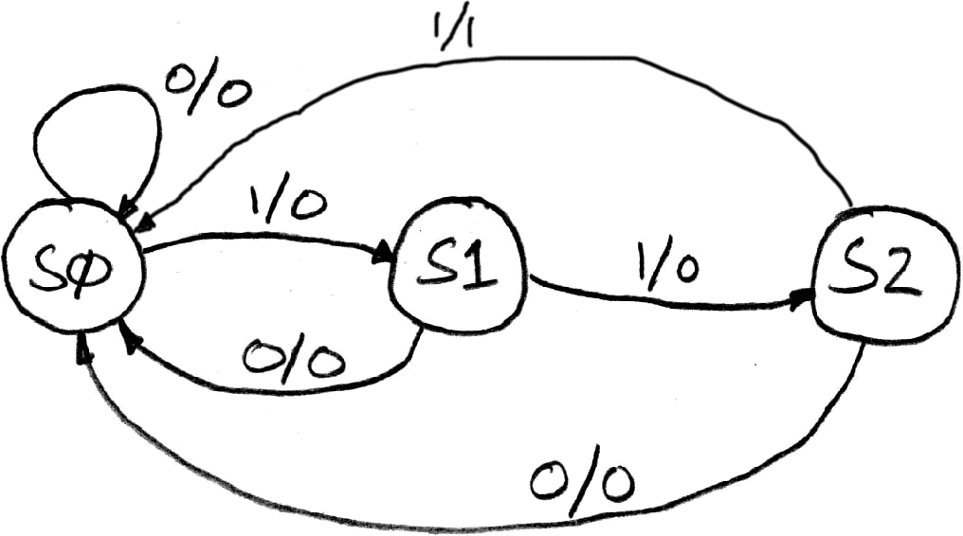
Finite State Machine Example: 3 ones…
FSM to detect the occurrence of 3 consecutive 1’s in the input.
Draw the FSM…
Assume state transitions are controlled by the clock:
on each clock cycle the machine checks the inputs and moves to a new state and produces a new output…

Slide 18
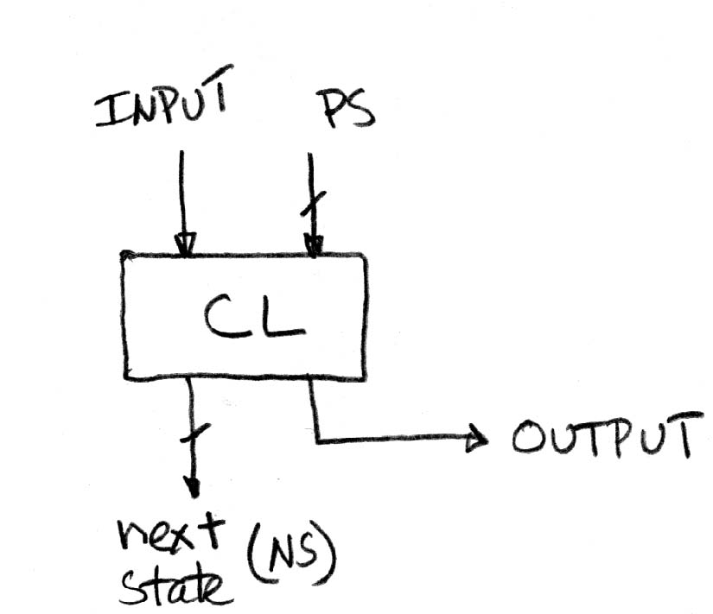
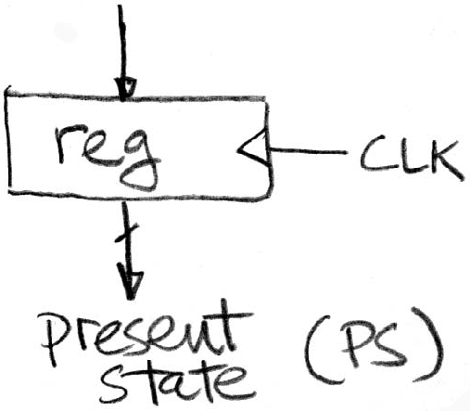
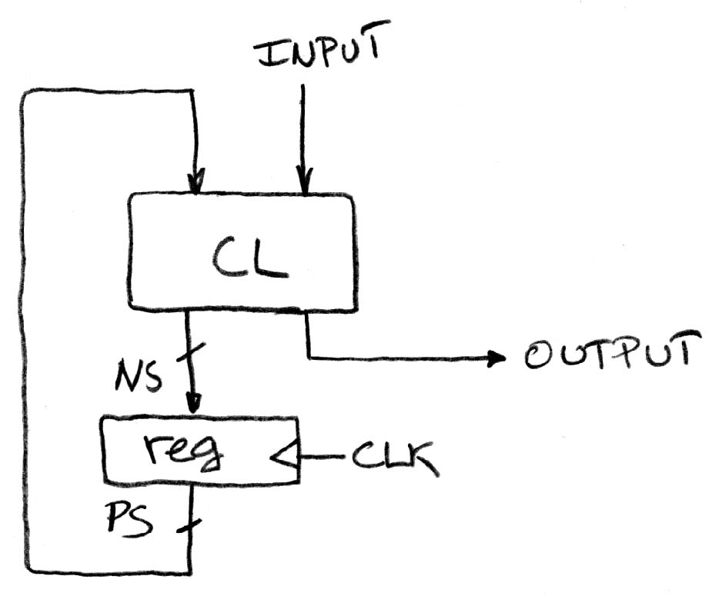
Hardware Implementation of FSM
… Therefore a register is needed to hold the a representation of which state the machine is in. Use a unique bit pattern for each state.
+
?
=
Combinational logic circuit is used to implement a function maps from present state and input to next state and output.

Slide 19
Hardware for FSM: Combinational Logic
Next lecture we will discuss the detailed implementation, but for now can look at its functional specification, truth table form.
Truth table…
PS
Input
NS
Output
00
0
00
0
00
1
01
0
01
0
00
0
01
1
10
0
10
0
00
0
10
1
00
1

Slide 20
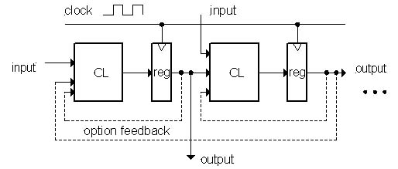
General Model for Synchronous Systems
Collection of CL blocks separated by registers.
Registers may be back-to-back and CL blocks may be back-to-back.
Feedback is optional.
Clock signal(s) connects only to clock input of registers.

Slide 21
Peer Instruction
HW feedback akin to SW recursion
The period of a usable synchronous circuit is greater than the CLK-to-Q delay
You can build a FSM to signal when an equal number of 0s and 1s has appeared in the input.
ABC
A: FFF
B: FTF
C: TFF
D: TTF
E: TTT
Notes:
Answer: [correct=5, TFF] Individual (6, 3, 6, 3, 34, 37, 7, 4)% & Team (9, 4, 4, 4, 39, 34, 0, 7)%
A: T [18/82 & 25/75] (The game breaks up very quickly into separate, independent games -- big win to solve separated & put together)
B: F [80/20 & 86/14] (The game tree grows exponentially! A better static evaluator can make all the difference!)
C: F [53/57 & 52/48] (If you're just looking for the best move, just keep theBestMove around [ala memoizing max])

Slide 22
Peer Instruction Answer
It needs ‘base case’ (reg reset), way to step from i to i+1 (use register + clock). True!
If not, will loose data! True!
How many states would it have? Say it’s n. How does it know when n+1 bits have been seen?
False!
HW feedback akin to SW recursion
The period of a usable synchronous circuit is greater than the CLK-to-Q delay
You can build a FSM to signal when an equal number of 0s and 1s has appeared in the input.
HW feedback akin to SW recursion
We can implement a D-Q flipflop as simple CL (And, Or, Not gates)
You can build a FSM to signal when an equal number of 0s and 1s has appeared in the input.
ABC
A: FFF
B: FTF
C: TFF
D: TTF
E: TTT
Notes:
Answer: [correct=5, TFF] Individual (6, 3, 6, 3, 34, 37, 7, 4)% & Team (9, 4, 4, 4, 39, 34, 0, 7)%
A: T [18/82 & 25/75] (The game breaks up very quickly into separate, independent games -- big win to solve separated & put together)
B: F [80/20 & 86/14] (The game tree grows exponentially! A better static evaluator can make all the difference!)
C: F [53/57 & 52/48] (If you're just looking for the best move, just keep theBestMove around [ala memoizing max])

Slide 23
“And In conclusion…”
State elements are used to:
Build memories
Control the flow of information between other state elements and combinational logic
D-flip-flops used to build registers
Clocks tell us when D-flip-flops change
Setup and Hold times important
We pipeline long-delay CL for faster clock
Finite State Machines extremely useful
You’ll see them again…

