Slide 1


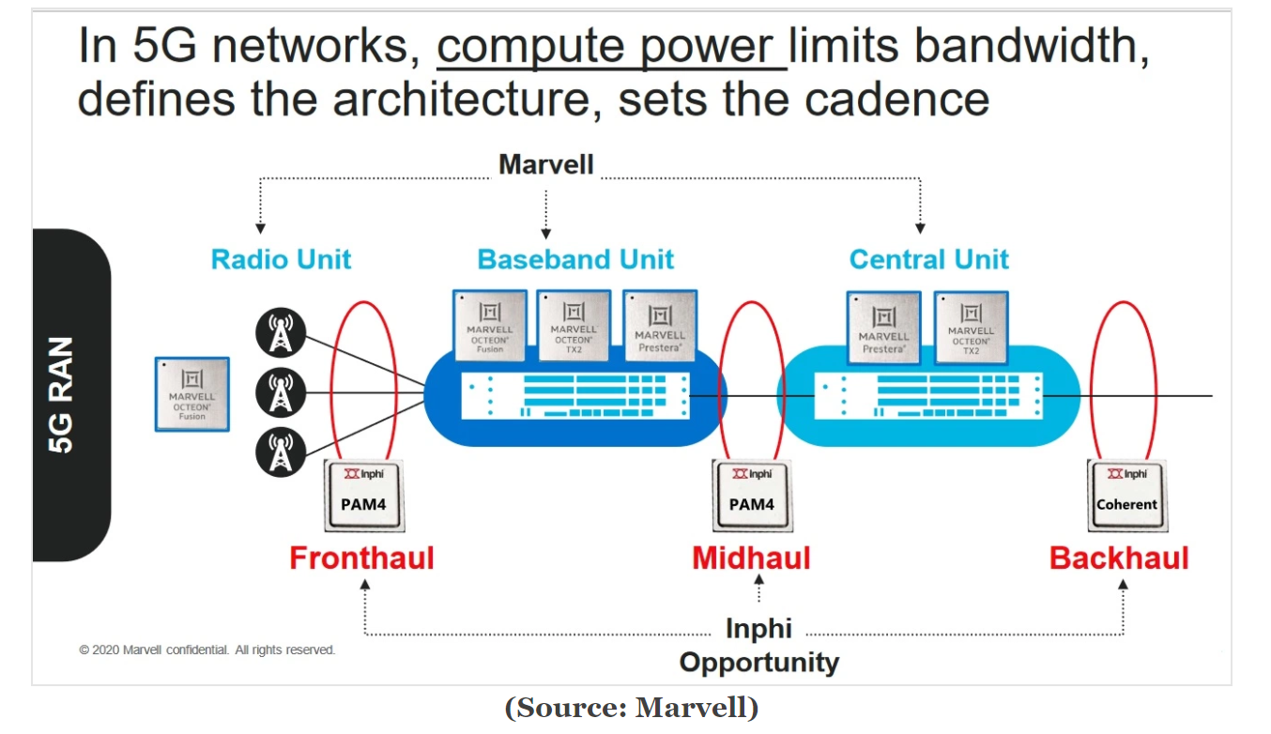
Computer Architecture
（计算机体系结构)
Lecture 29 – Caches III
2010-04-14
Lecturer Yuanqing Cheng

Slide 2
Review
Mechanism for transparent movement of data among levels of a storage hierarchy
  set of address/value bindings
  address ⇒ index to set of candidates
  compare desired address with tag
  service hit or miss
    load new block and binding on miss
address: tag index offset
000000000000000000 0000000001 1100
Valid
Tag
0xc-f
0x8-b
0x4-7
0x0-3
0
1
1
0
d
c
b
a
2
3
...

Slide 3
What to do on a write hit?
Write-through
  update the word in cache block and corresponding word in memory
Write-back
  update word in cache block
  allow memory word to be “stale”
  ⇒ add ‘dirty’ bit to each block indicating that memory needs to be updated when block is replaced
  ⇒ OS flushes cache before I/O…
Performance trade-offs?

Slide 4
Block Size Tradeoff (1/3)
Benefits of Larger Block Size
  Spatial Locality: if we access a given word, we’re likely to access other nearby words soon
  Very applicable with Stored-Program Concept: if we execute a given instruction, it’s likely that we’ll execute the next few as well
  Works nicely in sequential array accesses too
Notes:
As I said earlier, block size is a tradeoff. In general, larger block size will reduce the miss rate because it take advantage of spatial locality.
But remember, miss rate NOT the only cache performance metrics. You also have to worry about miss penalty.
As you increase the block size, your miss penalty will go up because as the block gets larger, it will take you longer to fill up the block.
Even if you look at miss rate by itself, which you should NOT, bigger block size does not always win. As you increase the block size, assuming keeping cache size constant, your miss rate will drop off rapidly at the beginning due to spatial locality.
However, once you pass certain point, your miss rate actually goes up.
As a result of these two curves, the Average Access Time (point to equation), which is really the more important performance metric than the miss rate, will go down initially because the miss rate is dropping much faster than the increase in miss penalty.
But eventually, as you keep on increasing the block size, the average access time can go up rapidly because not only is the miss penalty is increasing, the miss rate is increasing as well.
Let me show you why your miss rate may go up as you increase the block size by another extreme example.
+3 = 33 min. (Y:13)

Slide 5
Block Size Tradeoff (2/3)
Drawbacks of Larger Block Size
  Larger block size means larger miss penalty
    on a miss, takes longer time to load a new block from next level
  If block size is too big relative to cache size, then there are too few blocks
    Result: miss rate goes up
In general, minimize
Average Memory Access Time (AMAT)
  = Hit Time
  + Miss Penalty x Miss Rate

Slide 6
Block Size Tradeoff (3/3)
Hit Time
  time to find and retrieve data from current level cache
Miss Penalty
  average time to retrieve data on a current level miss (includes the possibility of misses on successive levels of memory hierarchy)
Hit Rate
  % of requests that are found in current level cache
Miss Rate
  1 - Hit Rate

Slide 7
Extreme Example: One Big Block
Cache Size = 4 bytes Block Size = 4 bytes
  Only ONE entry (row) in the cache!
If item accessed, likely accessed again soon
  But unlikely will be accessed again immediately!
The next access will likely to be a miss again
  Continually loading data into the cache but
  discard data (force out) before use it again
  Nightmare for cache designer: Ping Pong Effect
Valid Bit
Tag
Cache Data
B 3
B 2
B 1
B 0

Slide 8
Block Size Tradeoff Conclusions
Miss
Penalty
Miss
Rate
Exploits Spatial Locality
Fewer blocks:
compromises
temporal locality
Block Size
Block Size
Average
Access
Time
Increased Miss Penalty
& Miss Rate
Block Size

Slide 9
Types of Cache Misses (1/2)
“Three Cs” Model of Misses
1st C: Compulsory Misses
  occur when a program is first started
  cache does not contain any of that program’s data yet, so misses are bound to occur
  can’t be avoided easily, so won’t focus on these in this course

Slide 10
Types of Cache Misses (2/2)
2nd C: Conflict Misses
  miss that occurs because two distinct memory addresses map to the same cache location
  two blocks (which happen to map to the same location) can keep overwriting each other
  big problem in direct-mapped caches
  how do we lessen the effect of these?
Dealing with Conflict Misses
  Solution 1: Make the cache size bigger
    Fails at some point
  Solution 2: Multiple distinct blocks can fit in the same cache Index?

Slide 11
Fully Associative Cache (1/3)
Memory address fields:
  Tag: same as before
  Offset: same as before
  Index: non-existant
What does this mean?
  no “rows”: any block can go anywhere in the cache
  must compare with all tags in entire cache to see if data is there

Slide 12
Fully Associative Cache (2/3)
Fully Associative Cache (e.g., 32 B block)
  compare tags in parallel
31
4
0
Cache Tag (27 bits long)
Byte Offset
Cache Tag
Valid
Cache Data
=
B 31
:
B 1
B 0
=
=
=
:
:
:
:
=

Slide 13
Fully Associative Cache (3/3)
Benefit of Fully Assoc Cache
  No Conflict Misses (since data can go anywhere)
Drawbacks of Fully Assoc Cache
  Need hardware comparator for every single entry: if we have a 64KB of data in cache with 4B entries, we need 16K comparators: infeasible

Slide 14
Final Type of Cache Miss
3rd C: Capacity Misses
  miss that occurs because the cache has a limited size
  miss that would not occur if we increase the size of the cache
  sketchy definition, so just get the general idea
This is the primary type of miss for Fully Associative caches.

Slide 15
N-Way Set Associative Cache (1/3)
Memory address fields:
  Tag: same as before
  Offset: same as before
  Index: points us to the correct “row” (called a set in this case)
So what’s the difference?
  each set contains multiple blocks
  once we’ve found correct set, must compare with all tags in that set to find our data

Slide 16
Associative Cache Example
Cache
Index
Memory
Address
Here’s a simple 2-way set associative cache.
Memory
0
0
0
1
1
2
1
3
4
5
6
7
8
9
A
B
C
D
E
F
Notes:
Let’s look at the simplest cache one can build. A direct mapped cache that only has 4 bytes.
In this direct mapped cache with only 4 bytes, location 0 of the cache can be occupied by data form memory location 0, 4, 8, C, ... and so on.
While location 1 of the cache can be occupied by data from memory location 1, 5, 9, ... etc.
So in general, the cache location where a memory location can map to is uniquely determined by the 2 least significant bits of the address (Cache Index).
For example here, any memory location whose two least significant bits of the address are 0s can go to cache location zero.
With so many memory locations to chose from, which one should we place in the cache?
Of course, the one we have read or write most recently because by the principle of temporal locality, the one we just touch is most likely to be the one we will need again soon.
Of all the possible memory locations that can be placed in cache Location 0, how can we tell which one is in the cache?
+2 = 22 min. (Y:02)

Slide 17
N-Way Set Associative Cache (2/3)
Basic Idea
  cache is direct-mapped w/respect to sets
  each set is fully associative with N blocks in it
Given memory address:
  Find correct set using Index value.
  Compare Tag with all Tag values in the determined set.
  If a match occurs, hit!, otherwise a miss.
  Finally, use the offset field as usual to find the desired data within the block.

Slide 18
N-Way Set Associative Cache (3/3)
What’s so great about this?
  even a 2-way set assoc cache avoids a lot of conflict misses
  hardware cost isn’t that bad: only need N comparators
In fact, for a cache with M blocks,
  it’s Direct-Mapped if it’s 1-way set assoc
  it’s Fully Assoc if it’s M-way set assoc
  so these two are just special cases of the more general set associative design

Slide 19
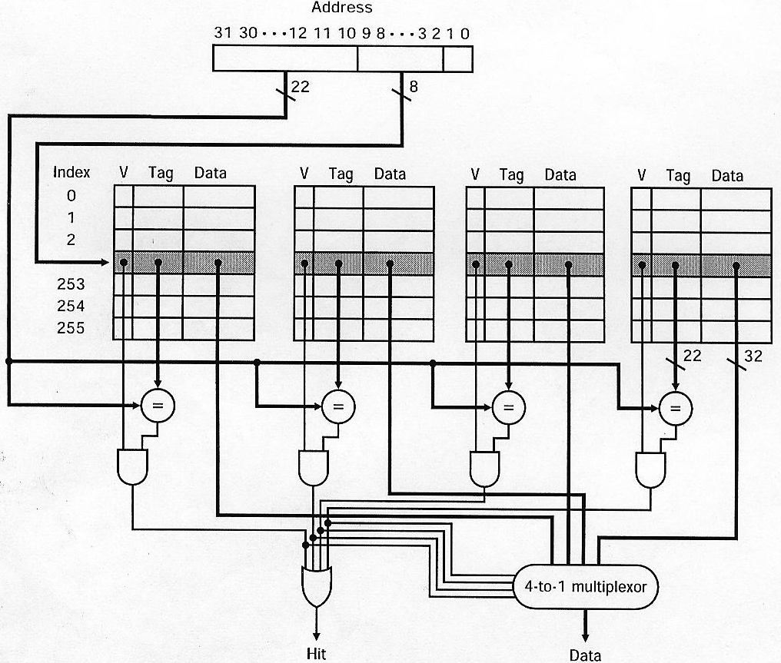
4-Way Set Associative Cache Circuit
tag
index

Slide 20
Block Replacement Policy
Direct-Mapped Cache
  index completely specifies position which position a block can go in on a miss
N-Way Set Assoc
  index specifies a set, but block can occupy any position within the set on a miss
Fully Associative
  block can be written into any position
Question: if we have the choice, where should we write an incoming block?
  If there are any locations with valid bit off (empty), then usually write the new block into the first one.
  If all possible locations already have a valid block, we must pick a replacement policy: rule by which we determine which block gets “cached out” on a miss.

Slide 21
Block Replacement Policy: LRU
LRU (Least Recently Used)
  Idea: cache out block which has been accessed (read or write) least recently
  Pro: temporal locality  recent past use implies likely future use: in fact, this is a very effective policy
  Con: with 2-way set assoc, easy to keep track (one LRU bit); with 4-way or greater, requires complicated hardware and much time to keep track of this

Slide 22
Block Replacement Example
We have a 2-way set associative cache with a four word total capacity and one word blocks. We perform the following word accesses (ignore bytes for this problem):
0, 2, 0, 1, 4, 0, 2, 3, 5, 4
How many hits and how many misses will there be for the LRU block replacement policy?

Slide 23
Block Replacement Example: LRU
loc 0
loc 1
set 0
0
lru
Addresses 0, 2, 0, 1, 4, 0, ...
0: miss, bring into set 0 (loc 0)
set 1
set 0
lru
0
lru
2
2: miss, bring into set 0 (loc 1)
set 1
set 0
lru
0
lru
2
0: hit
set 1
set 0
0
lru
2
1: miss, bring into set 1 (loc 0)
set 1
1
lru
set 0
lru
lru
0
4
4: miss, bring into set 0 (loc 1, replace 2)
2
set 1
1
lru
set 0
lru
lru
0
4
0: hit
set 1
1
lru

Slide 24
Big Idea
How to choose between associativity, block size, replacement & write policy?
Design against a performance model
  Minimize: Average Memory Access Time
  = Hit Time
  + Miss Penalty x Miss Rate
  influenced by technology & program behavior
Create the illusion of a memory that is large, cheap, and fast - on average
How can we improve miss penalty?

Slide 25
Improving Miss Penalty
When caches first became popular, Miss Penalty ~ 10 processor clock cycles
Today 2400 MHz Processor (0.4 ns per clock cycle) and 80 ns to go to DRAM
⇒ 200 processor clock cycles!
MEM
DRAM
Proc
$
$₂
Solution: another cache between memory and the processor cache: Second Level (L2) Cache

Slide 26
Peer Instruction
12
a) FF
b) FT
c) TF
d) TT
A 2-way set-associative cache can be outperformed by a direct-mapped cache.
Larger block size  lower miss rate

Slide 27
Peer Instruction Answer
Sure, consider the caches from the previous slides with the following workload: 0, 2, 0, 4, 2
2-way: 0m, 2m, 0h, 4m, 2m;
DM: 0m, 2m, 0h, 4m, 2h
Larger block size  lower miss rate, true until a certain point, and then the ping-pong effect takes over
12
a) FF
b) FT
c) TF
d) TT
A 2-way set-associative cache can be outperformed by a direct-mapped cache.
Larger block size  lower miss rate

Slide 28
And in Conclusion…
We’ve discussed memory caching in detail. Caching in general shows up over and over in computer systems
  Filesystem cache, Web page cache, Game databases / tablebases, Software memoization, Others?
Big idea: if something is expensive but we want to do it repeatedly, do it once and cache the result.
Cache design choices:
  Size of cache: speed v. capacity
  Block size (i.e., cache aspect ratio)
  Write Policy (Write through v. write back
  Associativity choice of N (direct-mapped v. set v. fully associative)
  Block replacement policy
  2nd level cache?
  3rd level cache?
Use performance model to pick between choices, depending on programs, technology, budget, ...

Slide 29
Bonus slides
These are extra slides that used to be included in lecture notes, but have been moved to this, the “bonus” area to serve as a supplement.
The slides will appear in the order they would have in the normal presentation
Bonus

Slide 30
Analyzing Multi-level cache hierarchy
DRAM
Proc
$
$₂
L1 hit
time
L2 hit
time
L2 Miss Rate
L2 Miss Penalty
L1 Miss Rate
L1 Miss Penalty
Avg Mem Access Time =
L1 Hit Time + L1 Miss Rate * L1 Miss Penalty
L1 Miss Penalty =
L2 Hit Time + L2 Miss Rate * L2 Miss Penalty
Avg Mem Access Time =
L1 Hit Time + L1 Miss Rate *
(L2 Hit Time + L2 Miss Rate * L2 Miss Penalty)

Slide 31
Example
Assume
  Hit Time = 1 cycle
  Miss rate = 5%
  Miss penalty = 20 cycles
  Calculate AMAT…
Avg mem access time
  = 1 + 0.05 x 20
  = 1 + 1 cycles
  = 2 cycles

Slide 32
Ways to reduce miss rate
Larger cache
  limited by cost and technology
  hit time of first level cache < cycle time (bigger caches are slower)
More places in the cache to put each block of memory – associativity
  fully-associative
    any block any line
  N-way set associated
    N places for each block
    direct map: N=1

Slide 33
Typical Scale
L1
  size: tens of KB
  hit time: complete in one clock cycle
  miss rates: 1-5%
L2:
  size: hundreds of KB
  hit time: few clock cycles
  miss rates: 10-20%
L2 miss rate is fraction of L1 misses that also miss in L2
  why so high?

Slide 34
Example: with L2 cache
Assume
  L1 Hit Time = 1 cycle
  L1 Miss rate = 5%
  L2 Hit Time = 5 cycles
  L2 Miss rate = 15% (% L1 misses that miss)
  L2 Miss Penalty = 200 cycles
L1 miss penalty = 5 + 0.15 * 200 = 35
Avg mem access time = 1 + 0.05 x 35
= 2.75 cycles

Slide 35
Example: without L2 cache
Assume
  L1 Hit Time = 1 cycle
  L1 Miss rate = 5%
  L1 Miss Penalty = 200 cycles
Avg mem access time = 1 + 0.05 x 200
= 11 cycles
4x faster with L2 cache! (2.75 vs. 11)

Slide 36
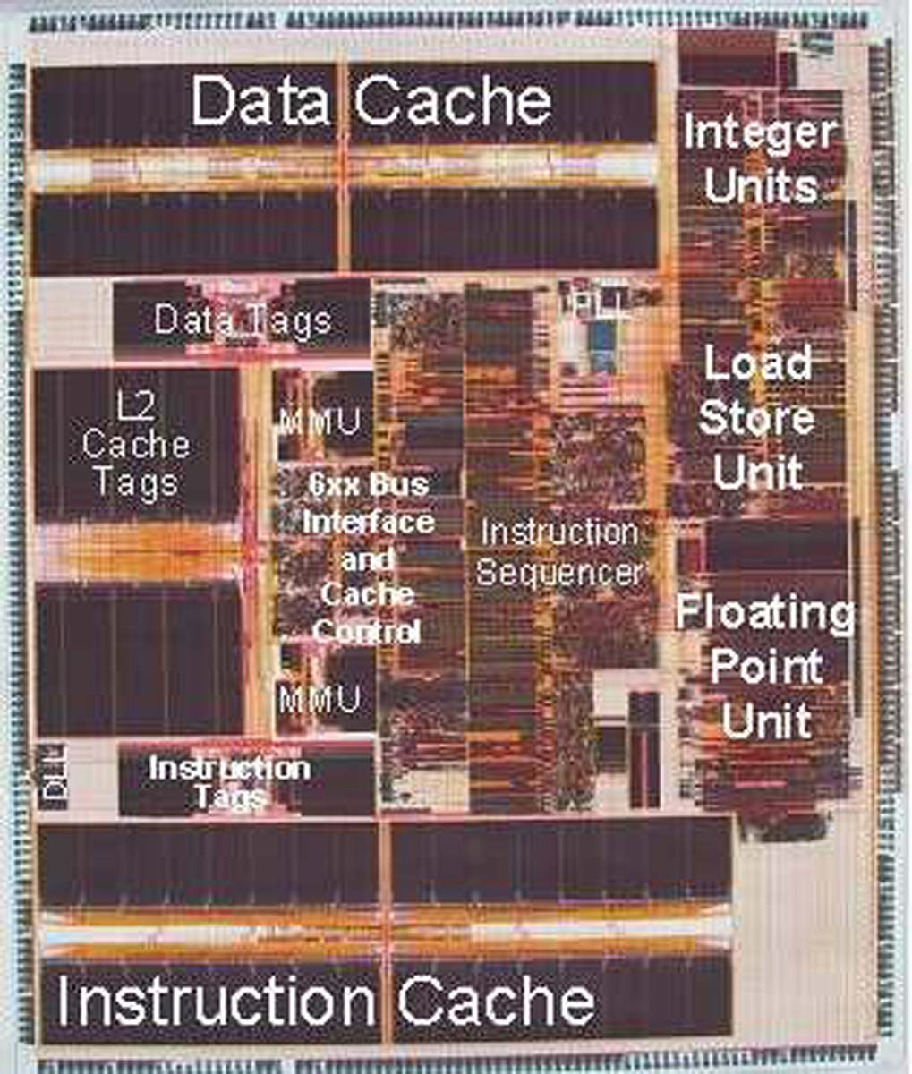
An actual CPU – Early PowerPC
Cache
  32 KB Instructions and 32 KB Data L1 caches
  External L2 Cache interface with integrated controller and cache tags, supports up to 1 MByte external L2 cache
  Dual Memory Management Units (MMU) with Translation Lookaside Buffers (TLB)
Pipelining
  Superscalar (3 inst/cycle)
  6 execution units (2 integer and 1 double precision IEEE floating point)

Slide 37
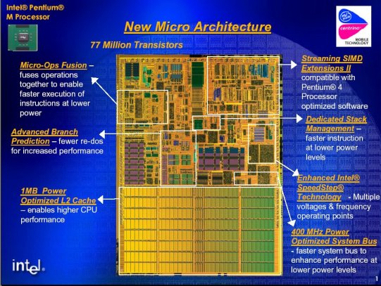
An Actual CPU – Pentium M
32KB I$
32KB D$

