Slide 1

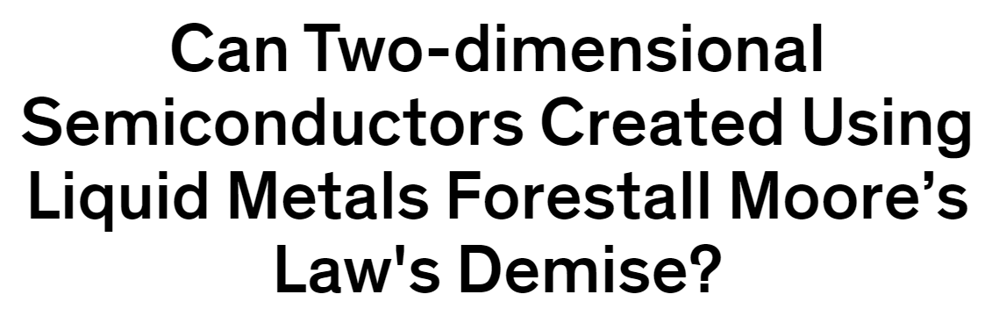
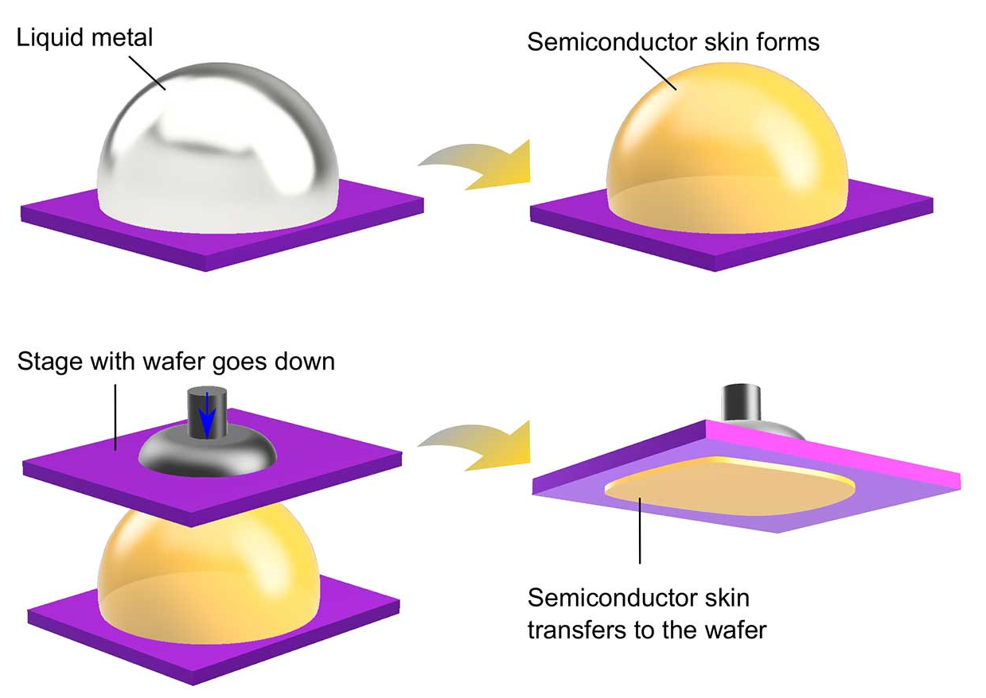

Computer Architecture
（计算机体系结构)
Lecture 31 – Virtual Memory II
2020-11-06
Lecturer Yuanqing Cheng

Slide 2
Review
Manage memory to disk? Treat as cache
  Included protection as bonus, now critical
  Use Page Table of mappings for each user
  vs. tag/data in cache
  TLB is cache of Virtual & Physical addr trans
Virtual Memory allows protected sharing of memory between processes
Spatial Locality means Working Set of Pages is all that must be in memory for process to run fairly well

Slide 3
Review Address Mapping: Page Table
Virtual Address:
page no.
offset
Page Table
Page Table
Base Reg
...
V
A.R.
P. P. A.
index
into
page
table
Access
Rights
Physical
Page
Address
+
Val
-id
Physical
Memory
Address
.
...
Page Table located in physical memory

Slide 4
Fetching data on a memory read
Check TLB (input: VPN, output: PPN)
  hit: fetch translation
  miss: check page table (in memory)
    Page table hit: fetch translation
    Page table miss: page fault, fetch page from disk to memory, return translation to TLB
Check cache (input: PPN, output: data)
  hit: return value
  miss: fetch value from memory, remember it in cache, return value
VA
hit
PA
Cache
Main
Memory
Processor
TLB
Lookup
miss
miss
hit
data
Trans-
lation

Slide 5
Address Translation using TLB
Virtual Address
VPN
TLB Tag
INDEX
Offset
TLB
...
TLB Tag
P. P. N.
(Tag used
just like
in cache)
Physical
Page
Number
TLB Tag
P. P. N.
PPN
Offset
Physical Address
Data Cache
Tag Data
Tag
INDEX
Offset
Tag Data

Slide 6
Typical TLB Format
TLB just a cache on the page table mappings
TLB access time comparable to cache
(much less than main memory access time)
Dirty: since use write back, need to know whether or not to write page to disk when replaced
Ref: Used to help calculate LRU on replacement
  Cleared by OS periodically, then checked to see if page was referenced
Physical Dirty Ref Valid Access
Tag Page # Rights

Slide 7
What if not in TLB?
Option 1: Hardware checks page table and loads new Page Table Entry into TLB
Option 2: Hardware traps to OS, up to OS to decide what to do
  MIPS follows Option 2: Hardware knows nothing about page table
  A trap is a synchronous exception in a user process, often resulting in the OS taking over and performing some action before returning to the program.
    More about exceptions next lecture

Slide 8
What if the data is on disk?
We load the page off the disk into a free block of memory, using a DMA transfer (Direct Memory Access – special hardware support to avoid processor)
  Meantime we switch to some other process waiting to be run
When the DMA is complete, we get an interrupt and update the process's page table
  So when we switch back to the task, the desired data will be in memory

Slide 9
What if we don’t have enough memory?
We chose some other page belonging to a program and transfer it onto the disk if it is dirty
  If clean (disk copy is up-to-date),
  just overwrite that data in memory
  We chose the page to evict based on replacement policy (e.g., LRU)
And update that program's page table to reflect the fact that its memory moved somewhere else
If continuously swap between disk and memory, called Thrashing

Slide 10
We’re done with new material
Let’s now review w/Questions

Slide 11
Question (1/3)
40-bit virtual address, 16 KB page
36-bit physical address
Number of bits in
Virtual Page Number/Page offset,
Physical Page Number/Page offset?
Virtual Page Number (? bits)
Page Offset (? bits)
Physical Page Number (? bits)
Page Offset (? bits)
1: 22/18 (VPN/PO), 22/14 (PPN/PO)
2: 24/16, 20/16
3: 26/14, 22/14
4: 26/14, 26/10
5: 28/12, 24/12

Slide 12
(1/3) Answer
40-bit virtual address, 16 KB page
36-bit physical address
Number of bits in
Virtual Page Number/Page offset,
Physical Page Number/Page offset?
Virtual Page Number (26 bits)
Page Offset (14 bits)
Physical Page Number (22 bits)
Page Offset (14 bits)
1: 22/18 (VPN/PO), 22/14 (PPN/PO)
2: 24/16, 20/16
3: 26/14, 22/14
4: 26/14, 26/10
5: 28/12, 24/12

Slide 13
Question (2/3): 40b VA, 36b PA
2-way set-assoc. TLB, 512 entries, 40b VA:
TLB Entry: Valid bit, Dirty bit,
Access Control (say 2 bits),
Virtual Page Number, Physical Page Number
Number of bits in TLB Tag / Index / Entry?
TLB Tag (? bits)
TLB Index (? bits)
Page Offset (14 bits)
V
D
Access (2 bits)
TLB Tag (? bits)
Physical Page No. (? bits)
1: 12 / 14 / 38 (TLB Tag / Index / Entry)
2: 14 / 12 / 40
3: 18 / 8 / 44
4: 18 / 8 / 58

Slide 14
(2/3) Answer
2-way set-assoc data cache, 256 (2⁸) “sets”, 2 TLB entries per set => 8 bit index
TLB Entry: Valid bit, Dirty bit,
Access Control (2 bits),
Virtual Page Number, Physical Page Number
TLB Tag (18 bits)
TLB Index (8 bits)
Page Offset (14 bits)
Virtual Page Number (26 bits)
V
D
1: 12 / 14 / 38 (TLB Tag / Index / Entry)
2: 14 / 12 / 40
3: 18 / 8 / 44
4: 18 / 8 / 58
Access (2 bits)
TLB Tag (18 bits)
Physical Page No. (22 bits)

Slide 15
Question (3/3)
2-way set-assoc, 64KB data cache, 64B block
Data Cache Entry: Valid bit, Dirty bit, Cache tag + ? bits of Data
Number of bits in Data cache Tag / Index / Offset / Entry?
Cache Tag (? bits)
Cache Index (? bits)
Block Offset (? bits)
Physical Page Address (36 bits)
V
D
Cache Tag (? bits)
Cache Data (? bits)
1: 12 / 9 / 14 / 87 (Tag/Index/Offset/Entry)
2: 20 / 10 / 6 / 86
3: 20 / 10 / 6 / 534
4: 21 / 9 / 6 / 87
5: 21 / 9 / 6 / 535

Slide 16
(3/3) Answer
2-way set-assoc data cache, 64K/1K (2¹⁰) “sets”, 2 entries per sets => 9 bit index
Data Cache Entry: Valid bit, Dirty bit, Cache tag + 64 Bytes of Data
Cache Tag (21 bits)
Cache Index (9 bits)
Block Offset (6 bits)
Physical Page Address (36 bits)
1: 12 / 9 / 14 / 87 (Tag/Index/Offset/Entry)
2: 20 / 10 / 6 / 86
3: 20 / 10 / 6 / 534
4: 21 / 9 / 6 / 87
5: 21 / 9 / 6 / 535
V
D
Cache Tag (21 bits)
Cache Data (64 Bytes = 512 bits)

Slide 17
And in Conclusion…
Virtual memory to Physical Memory Translation too slow?
  Add a cache of Virtual to Physical Address Translations, called a TLB
Spatial Locality means Working Set of Pages is all that must be in memory for process to run fairly well
Virtual Memory allows protected sharing of memory between processes with less swapping to disk

Slide 18
Bonus slides
These are extra slides that used to be included in lecture notes, but have been moved to this, the “bonus” area to serve as a supplement.
The slides will appear in the order they would have in the normal presentation
Bonus

Slide 19
4 Qs for any Memory Hierarchy
Q1: Where can a block be placed?
  One place (direct mapped)
  A few places (set associative)
  Any place (fully associative)
Q2: How is a block found?
  Indexing (as in a direct-mapped cache)
  Limited search (as in a set-associative cache)
  Full search (as in a fully associative cache)
  Separate lookup table (as in a page table)
Q3: Which block is replaced on a miss?
  Least recently used (LRU)
  Random
Q4: How are writes handled?
  Write through (Level never inconsistent w/lower)
  Write back (Could be “dirty”, must have dirty bit)

Slide 20
Q1: Where block placed in upper level?
Block #12 placed in 8 block cache:
  Fully associative
  Direct mapped
  2-way set associative
    Set Associative Mapping = Block # Mod # of Sets
Block
no.
Block
no.
0 1 2 3 4 5 6 7
Block
no.
0 1 2 3 4 5 6 7
0 1 2 3 4 5 6 7
Fully associative:
block 12 can go anywhere
Set
0
Set
1
Set
2
Set
3
Direct mapped:
block 12 can go only into block 4 (12 mod 8)
Set associative:
block 12 can go anywhere in set 0 (12 mod 4)

Slide 21
Q2: How is a block found in upper level?
Block Address
Block
offset
Tag
Index
Set Select
Data Select
Direct indexing (using index and block offset), tag compares, or combination
Increasing associativity shrinks index, expands tag

Slide 22
Q3: Which block replaced on a miss?
Easy for Direct Mapped
Set Associative or Fully Associative:
  Random
  LRU (Least Recently Used)
Miss Rates
Associativity: 2-way 4-way 8-way
Size LRU Ran LRU Ran LRU Ran
16 KB 5.2% 5.7% 4.7% 5.3% 4.4% 5.0%
64 KB 1.9% 2.0% 1.5% 1.7% 1.4% 1.5%
256 KB 1.15% 1.17% 1.13% 1.13% 1.12% 1.12%

Slide 23
Q4: What to do on a write hit?
Write-through
  update the word in cache block and corresponding word in memory
Write-back
  update word in cache block
  allow memory word to be “stale”
  => add ‘dirty’ bit to each line indicating that memory be updated when block is replaced
  => OS flushes cache before I/O !!!
Performance trade-offs?
  WT: read misses cannot result in writes
  WB: no writes of repeated writes

Slide 24
Three Advantages of Virtual Memory
1) Translation:
  Program can be given consistent view of memory, even though physical memory is scrambled
  Makes multiple processes reasonable
  Only the most important part of program (“Working Set”) must be in physical memory
  Contiguous structures (like stacks) use only as much physical memory as necessary yet still grow later

Slide 25
Three Advantages of Virtual Memory
2) Protection:
  Different processes protected from each other
  Different pages can be given special behavior
    (Read Only, Invisible to user programs, etc).
  Kernel data protected from User programs
  Very important for protection from malicious programs  Far more “viruses” under Microsoft Windows
  Special Mode in processor (“Kernel mode”) allows processor to change page table/TLB
3) Sharing:
  Can map same physical page to multiple users
  (“Shared memory”)

Slide 26
Why Translation Lookaside Buffer (TLB)?
Paging is most popular implementation of virtual memory
(vs. base/bounds)
Every paged virtual memory access must be checked against Entry of Page Table in memory to provide protection / indirection
Cache of Page Table Entries (TLB) makes address translation possible without memory access in common case to make fast

Slide 27
Bonus slide: Virtual Memory Overview (1/3)
User program view of memory:
  Contiguous
  Start from some set address
  Infinitely large
  Is the only running program
Reality:
  Non-contiguous
  Start wherever available memory is
  Finite size
  Many programs running at a time

Slide 28
Bonus slide: Virtual Memory Overview (2/3)
Virtual memory provides:
  illusion of contiguous memory
  all programs starting at same set address
  illusion of ~ infinite memory
  (232 or 264 bytes)
  protection

Slide 29
Bonus slide: Virtual Memory Overview (3/3)
Implementation:
  Divide memory into “chunks” (pages)
  Operating system controls page table that maps virtual addresses into physical addresses
  Think of memory as a cache for disk
  TLB is a cache for the page table

Slide 30
Address Map, Mathematically
V = {0, 1, . . . , n - 1} virtual address space (n > m)
M = {0, 1, . . . , m - 1} physical address space
MAP: V --> M U {θ} address mapping function
MAP(a) = a' if data at virtual address a
is present in physical address a' and a' in M
= θ if data at virtual address a is not present in M
a
page fault
Name Space V
OS fault
handler
Processor
Addr Trans
Mechanism
0
Main
Memory
Disk
a
a'
physical
address
OS performs
this transfer

